Slide 1


Slide 2
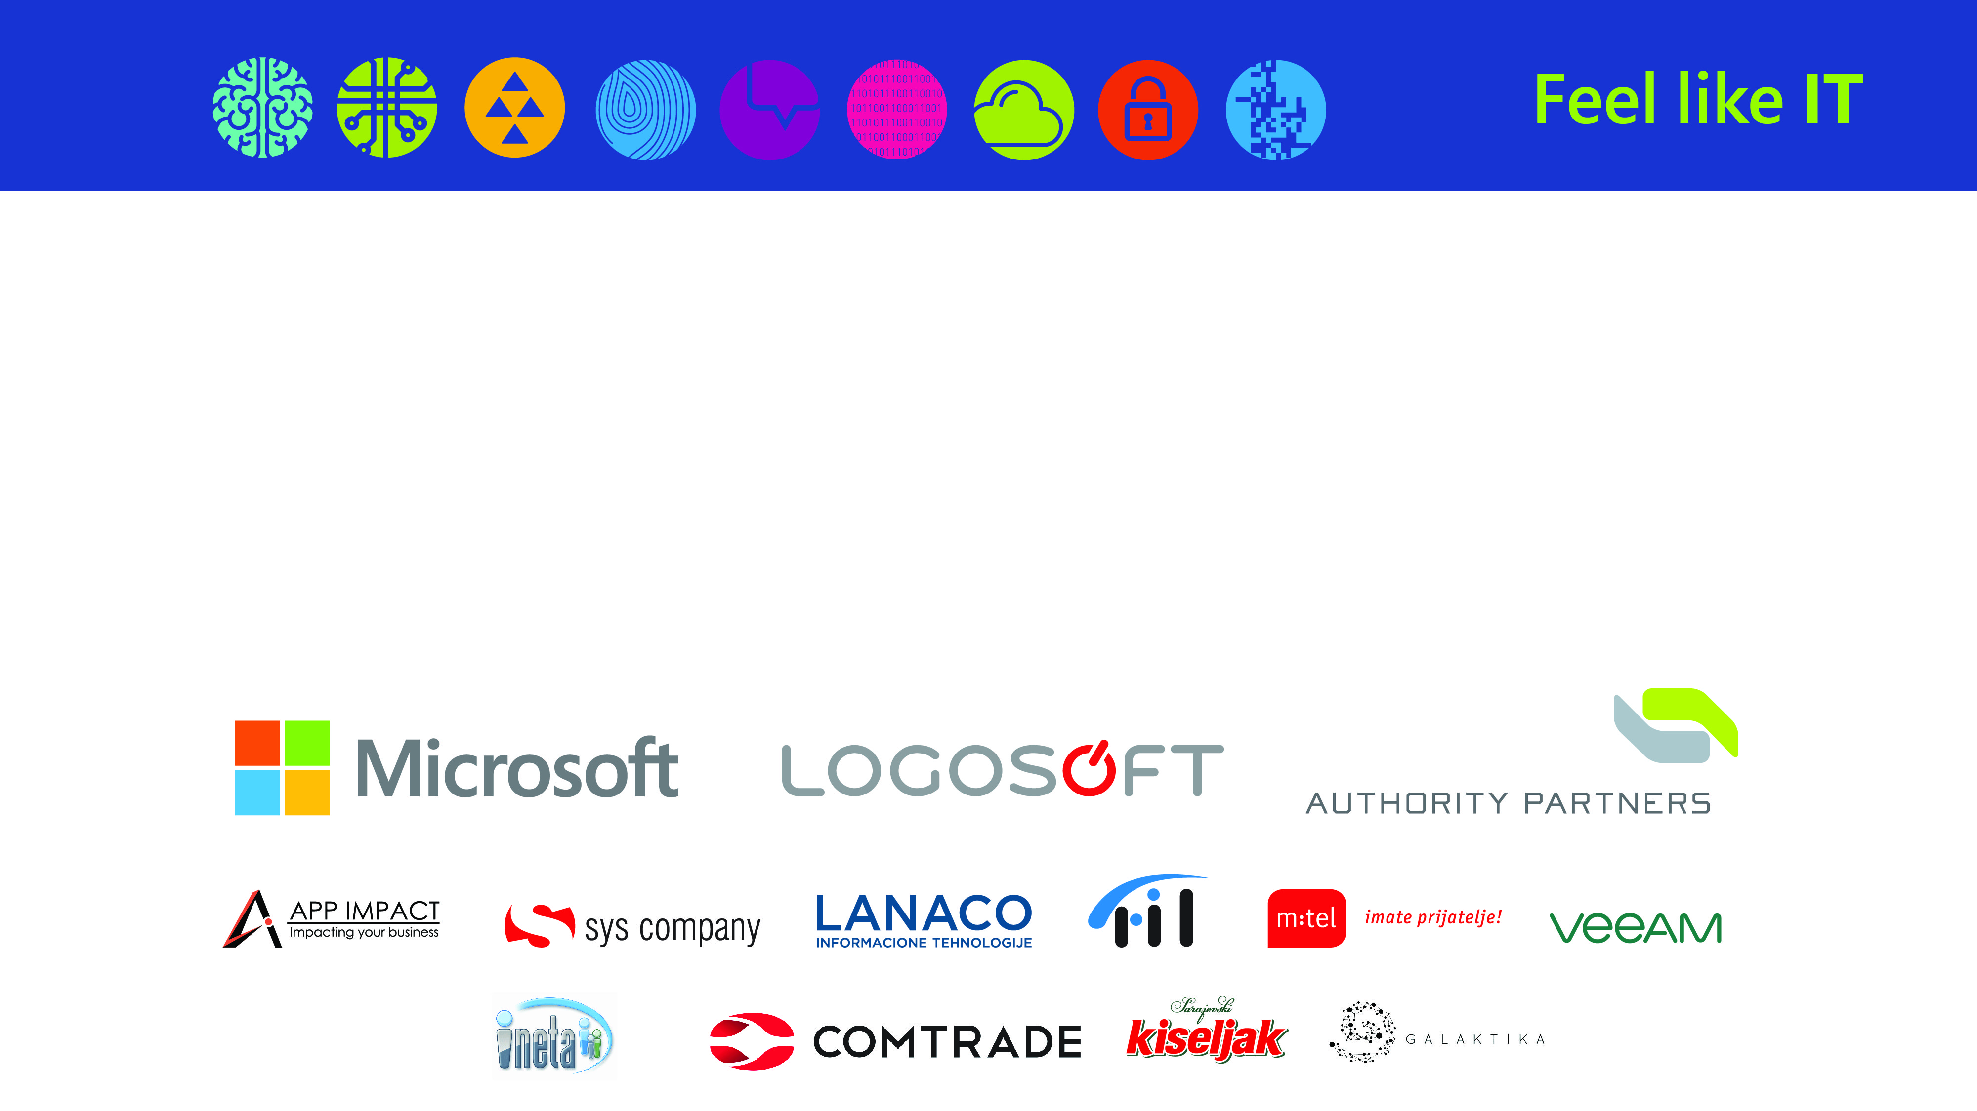
Building production ready APIs
with ASP.NET Core 2.0

Slide 3
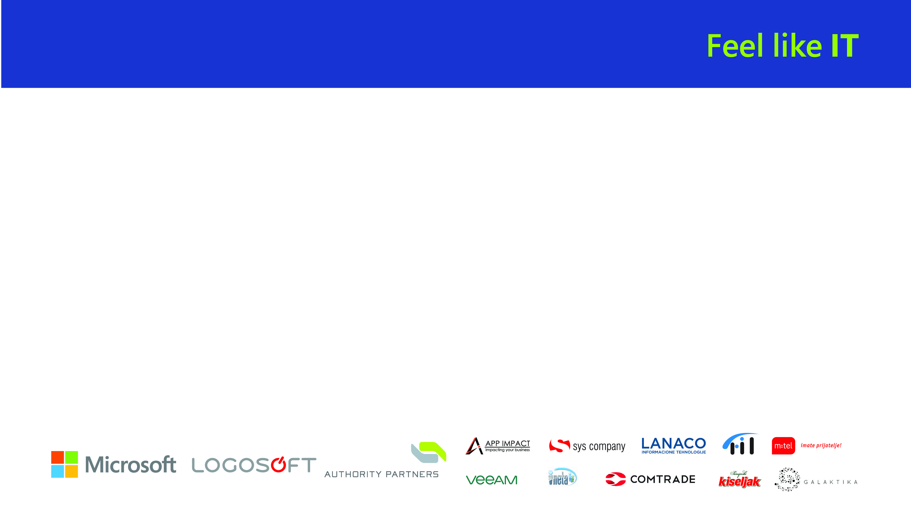
REST(ful)
REST – architecture type that’s using the existing web infrastructure
RESTful – services that implement REST architecture
Strict and pragmatic approach
Web resources – identified with web address
HTTP verbs – GET, POST, PUT, DELETE, PATCH…
JSON or XML

Slide 4
ASP.NET Core 2.0
Released on August 14.
.NET Framework 4.6.1 and .NET Core 2.0
Microsoft.AspNetCore.All metapackage
Razor Pages, new project templates
Improved configuration, logging and authentication APIs

Slide 5
Dependency Injection
public class GamesController : Controller
{
private readonly IGamesRepository _gamesRepository;
public GamesController(IGamesRepository gamesRepository)
{
_gamesRepository = gamesRepository;
}
public IActionResult GetAll()
{
var games = _gamesRepository.GetAll();
return Ok(games);
}
}
// Startup.cs
public void ConfigureServices(IServiceCollection services)
{
services.AddSingleton<IGamesRepository, GamesRepository>();
services.AddMvc();
}

Slide 6
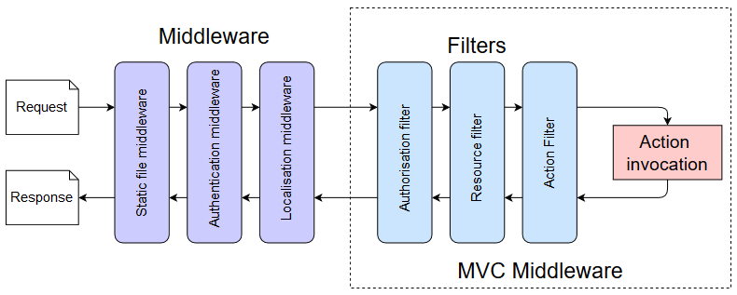
Middleware / Action Filters
public class SimpleMiddleware
{
private readonly RequestDelegate _next;
public SimpleMiddleware(RequestDelegate next)
{
_next = next;
}
public async Task Invoke(HttpContext httpContext)
{
httpContext.Response.Headers.Add("Middleware", "Hello");
await _next.Invoke(httpContext);
}
}
// Startup.cs
public void Configure(IApplicationBuilder app, IHostingEnvironment env)
{
app.UseMiddleware<SimpleMiddleware>();
app.UseMvc();
}

Slide 7
Routing
Conventions / configuration
Attribute routing
[Route("api/[controller]")]
public class GamesController : Controller
{
// ...
[HttpDelete("{id}")]
public IActionResult Delete(string id)
{
_gamesRepository.Delete(id);
return Ok();
}
[HttpGet]
public IActionResult GetAll()
{
var games = _gamesRepository.GetAll();
return Ok(games);
}
}
// Startup.cs app.UseMvc(routes => {
routes.MapRoute(
name: "default",
template: "{controller=Home}/{action=Index}/{id?}");
});

Slide 8
Content Negotiation
JSON is default
Headers
Accept: application/xml
services.AddMvc().AddXmlSerializerFormatters();
URL mapping
/products/4
/products/4.json
/products/4.xml
[FormatFilter]
public class ProductsController
{
[HttpGet("[controller]/[action]/{id}.{format?}")]
public Product GetById(int id)

Slide 9
Configuration
appsettings.json
appsettings.Development.json (environment)
User secrets
Environment variables
Console line arguments
Custom - IConfigurationBuilder
public class Program
{
public static void Main(string[] args)
{
BuildWebHost(args).Run();
}
public static IWebHost BuildWebHost(string[] args) =>
WebHost.CreateDefaultBuilder(args)
.UseStartup<Startup>()
.Build();
}

Slide 10
Logging
WebHost.CreateDefaultBuilder()
Console
Debug
ILogger, ILogger<T>
Custom – ILoggingBuilder
NLog, Log4Net, Elmah, Serilog…

Slide 11
Production ready?

Slide 12
Best practices
IActionResult
Model / input validation
Exception handling
Logging
Custom response object
Paging

Slide 13
Security
HTTPS
“Auth 2.0” u ASP.NET Core 2.0
OAuth 2.0
Token based authentication
Identity Server 4 - http://identityserver.io/
Third party
Auth0 - https://auth0.com/
Okta - https://developer.okta.com/
…

Slide 14
Testing
Unit testing
Integration testing
Manual testing
Tools (Postman, Fiddler…)

Slide 15
Documentation
http://swagger.io/
De-facto standard for REST API documentation
API framework – not just for documentation purpose
Used to define an API
Automated API testing
Code generation...
MS use it for all of their Azure APIs
Swashbuckle NuGet and Swagger UI

Slide 16
Deployment
Right click -> Publish…, Git push, custom build script…
Azure, AWS, Digital Ocean…
Docker
Continuous integration / delivery
Visual Studio Team Services
TeamCity
AppVeyor
…

Slide 17

Rainbows and unicorns

Slide 18
Limiting
Limit per token
Implementation through Middleware or action filter
https://github.com/stefanprodan/AspNetCoreRateLimit
Limit per Client IP
Limit per Client ID header

Slide 19
Versioning
URL
/api/v2/games/
Query string
/api/games?api-version=2
Custom request header
api-version: 2
Accept header
Accept: application/json;v=2
Microsoft.AspNetCore.Mvc.Versioning
Supports all types, query string by default (?api-version=2)

Slide 20
Monitoring
Simple logging – errors, logs
Performance tracking
Usage tracking
Azure – Azure Monitor, Application Insights, Log Analytics…
https://getwarden.net/ - Warden, open-source, cross-platform
Third-party monitoring services
Google Analytics API
https://newrelic.com/
https://stackify.com/
http://www.monitis.com/
https://www.runscope.com/
…

Slide 21
Summary
Basics – REST, ASP.NET 2
Best practices
Security
Testing
Documentation
Deployment
Limiting
Versioning
Monitoring

Slide 22
Further reading
https://github.com/Microsoft/api-guidelines
Specifikacije
HATEOAS – Hypermedia as the Engine of Application State
https://ionwg.org/ - The ION Hypermedia Type
http://jsonapi.org/ - JSON API Specification
http://json-schema.org/ - JSON (Hyper-)Schema…
http://graphql.org/ - GraphQL
APIs
https://dev.twitter.com/rest/public - Twitter REST
https://developer.github.com/v3/ - GitHub REST / v4 GraphQL
https://stripe.com/docs/api - Stripe
https://www.twilio.com/docs/api/rest - Twilio
https://developers.digitalocean.com/documentation/v2/ - Digital Ocean
https://github.com/nbarbettini/BeautifulRestApi - samples and video course
https://github.com/miroslavpopovic/production-ready-apis-sample - source code

Slide 23
HVALA NA PAŽNJI!
Pitanja?
MOLIM VAS DA POPUNITE ANKETE

